Slide 1
Exploring HLA Class II and KIR regions from Pangenome for GFE Annotation
Jason Chin, Haipeng Liu, Nick Pollock
DaSH 13 HLA & KIR Hackathon
Rochester, MN
9/13/2023 - 9/15/2023

Slide 2
Introduction
GFE
HLA-DQB1w0-4-0-141-0-12-0-4-0-0-0-0-0
Pangenomics
HLA Class II & KIR
Tools used, protein to DNA aligner:
Immuannot.
Miniprot.
KIR and HLA Class II protein sequences downloaded from IMGT
KIR and HLA Class II genomic sequences fetched from pangenome

Slide 3
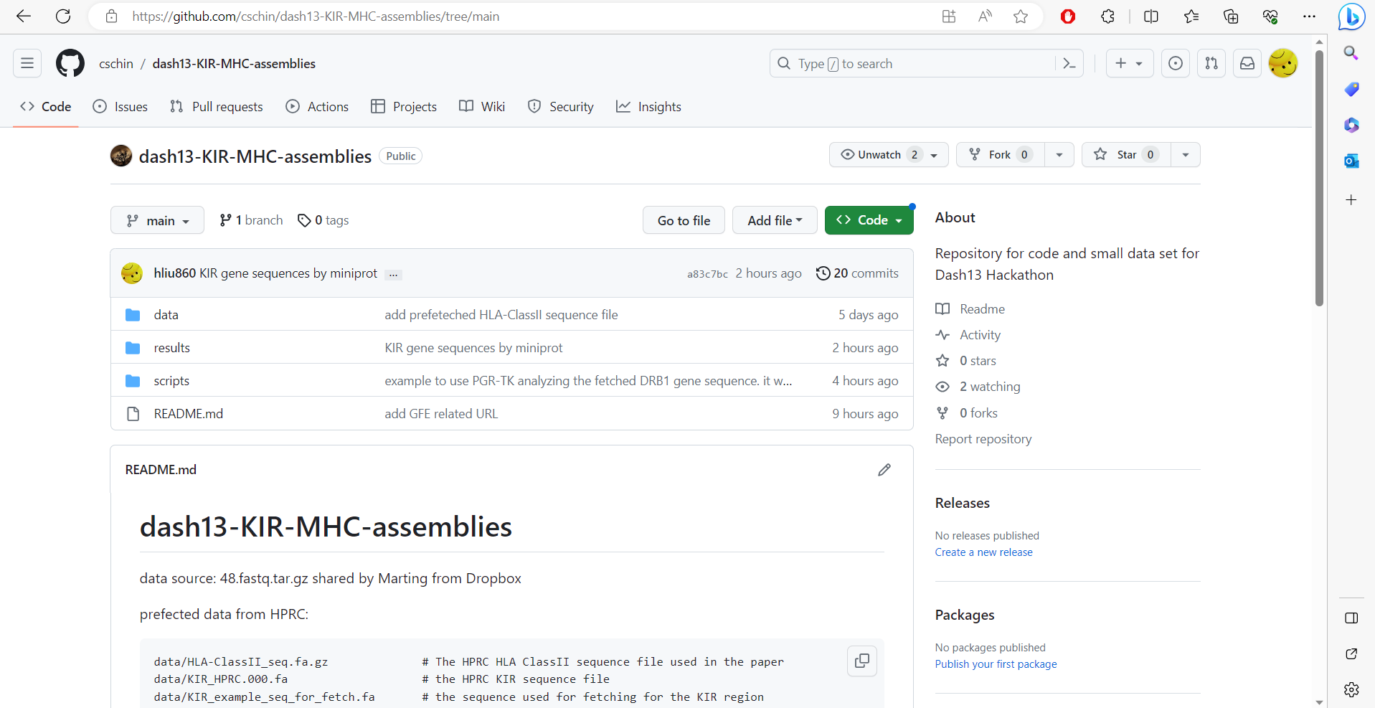

Slide 4
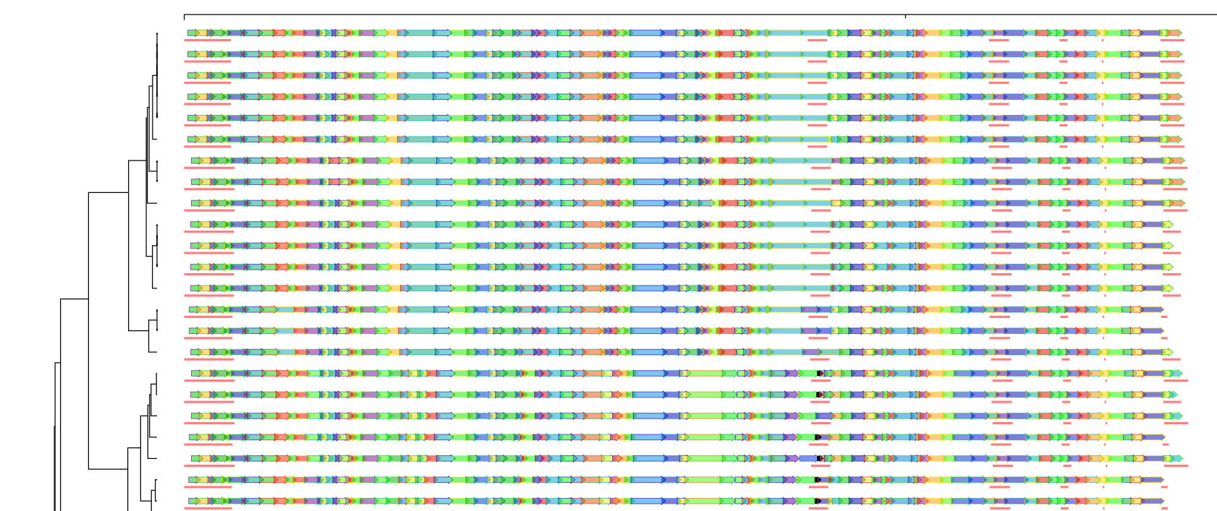
HLA DRB1 in linear pangenome visualization with exon annotation

Slide 5
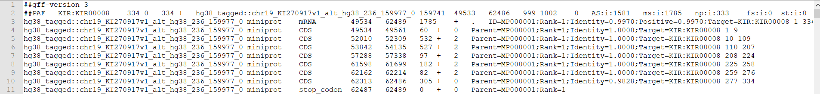
KIR 2DL1 example on exon annotation
KIR2DL1
Exon 1
Exon 2
Exon 3
Exon 4
…

Slide 6
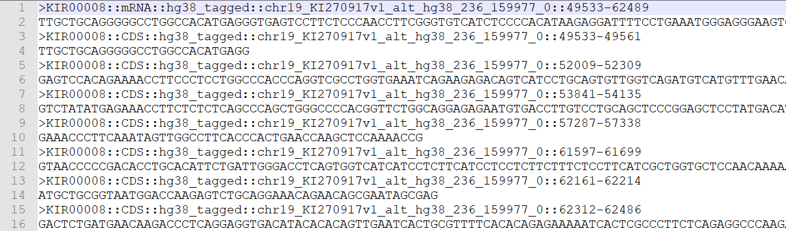
KIR 2DL1 example on exon annotation, cont.
Exon 1
Exon 2
Exon 3
Exon 4
…

Slide 7
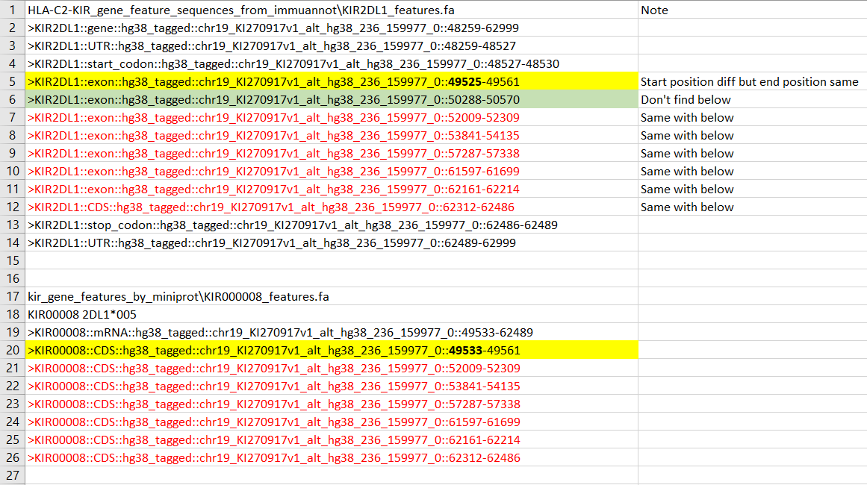
KIR 2DL1 comparison 1: immuannot VS miniprot

Slide 8
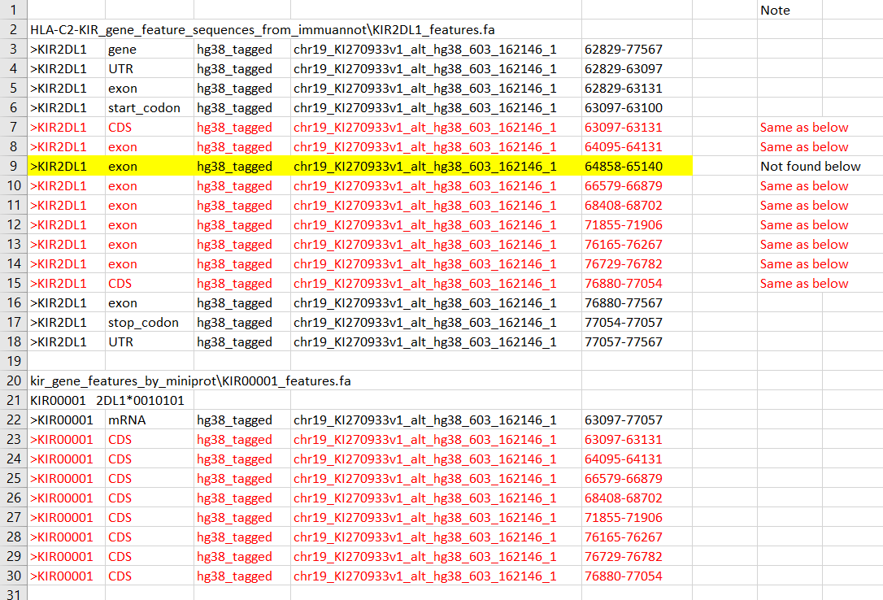
KIR 2DL1 comparison 2: immuannot VS miniprot

Slide 9
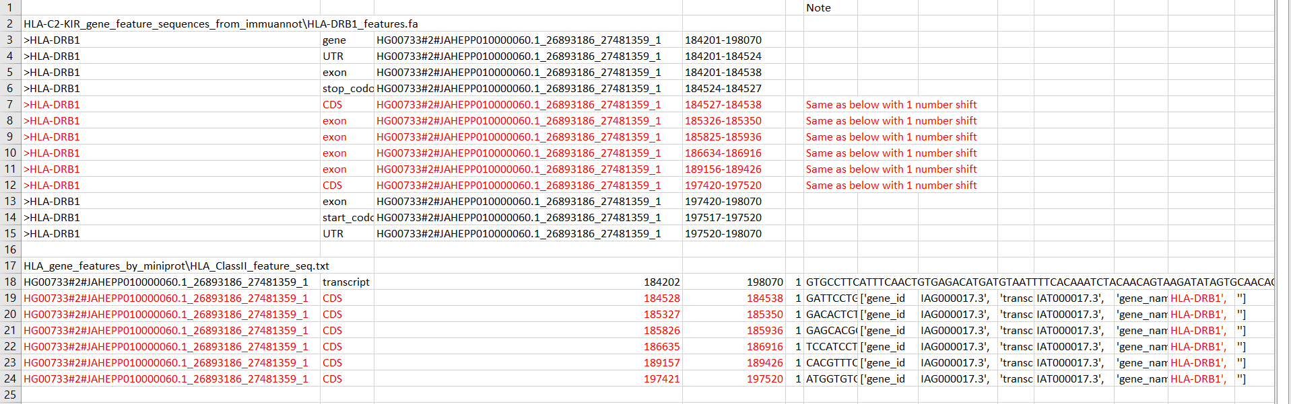
HLA DRB1 comparison: immuannot vs miniprot

Slide 10
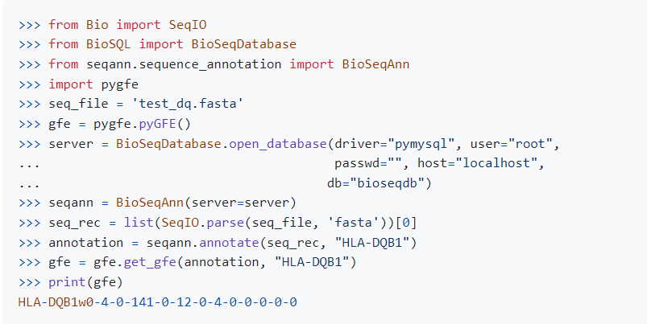
Next steps
Use pygfe to convert sequences to GFE.
Use GFT to investigate the HLA Class II & KIR regions fetched from pangenome

